Slide 1
DE1: Movie Analysis
Team Lagos

Slide 2
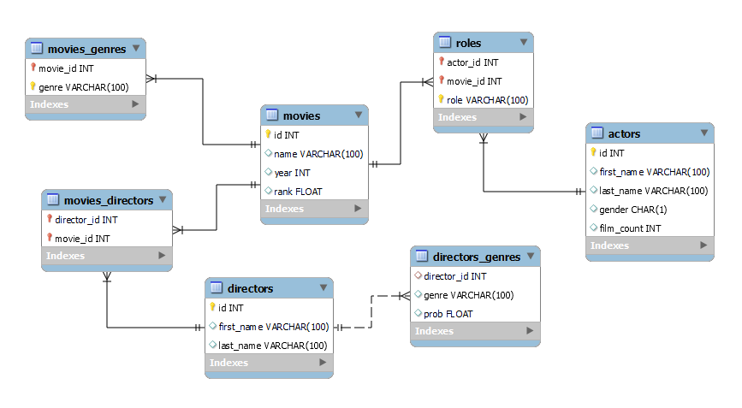
IMDb Database

Slide 3
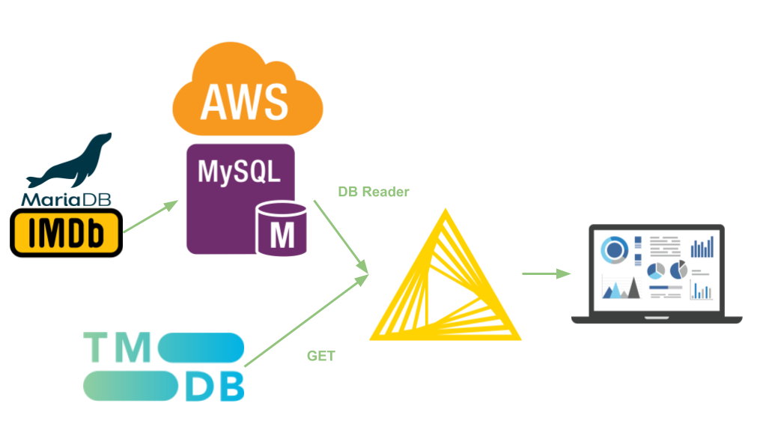
Data Pipeline

Slide 4
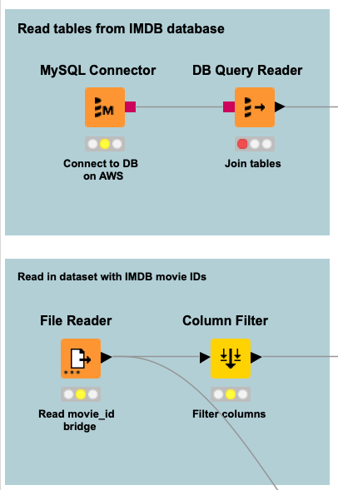



IMDb Extract

Slide 5

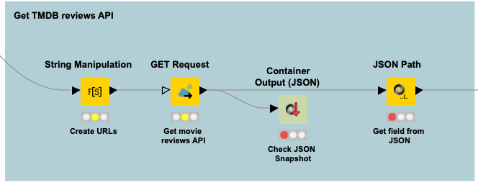
TMDb Extract

Slide 6

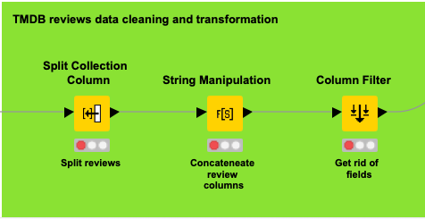
Transform

Slide 7
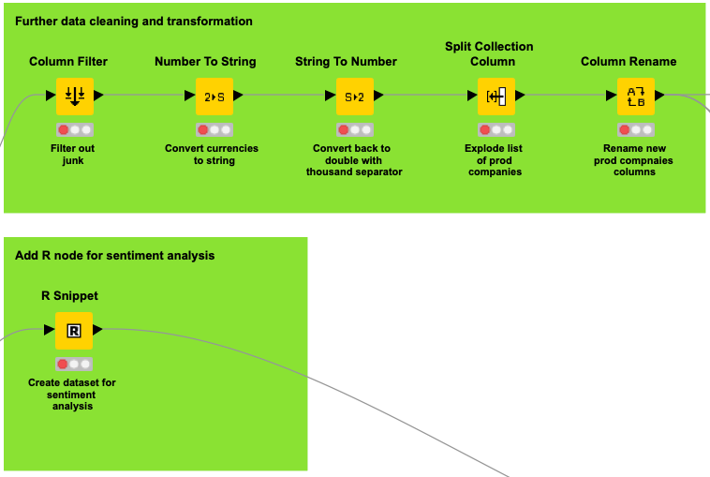
Transform

Slide 8
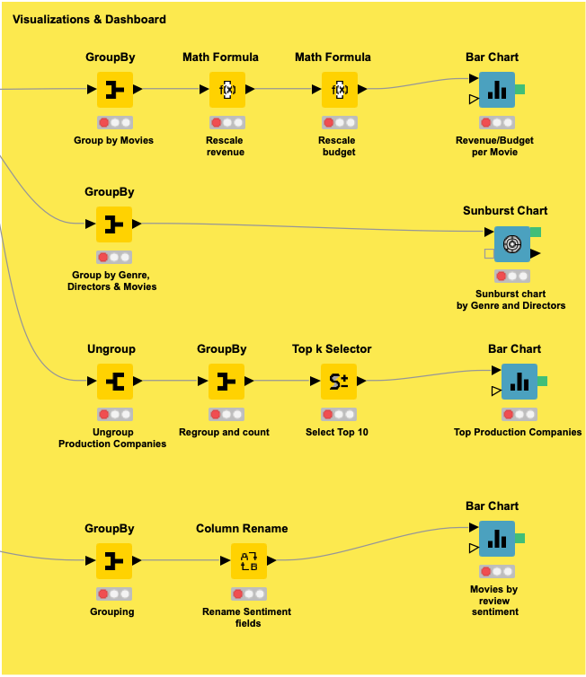
Load

Slide 9
